Slide 1
Manufacturing, ports, and vessels assessment
Scenarios and bottlenecks

Slide 2
Goals
Define a baseline domestic supply chain scenario based on demand for facilities and feasible port locations
Establish a Gantt chart for construction of these facilities
Evaluate how the number of marshaling ports and WTIVs impact the deployment rate of East Coast pipeline
Establish a Gantt chart for installation of offshore wind projects
Identify key takeaways, barriers, and recommendations for stakeholders

Slide 3
Baseline supply chain scenario
Accompanying data: Fabrication_port_screening.xlsx

Slide 4
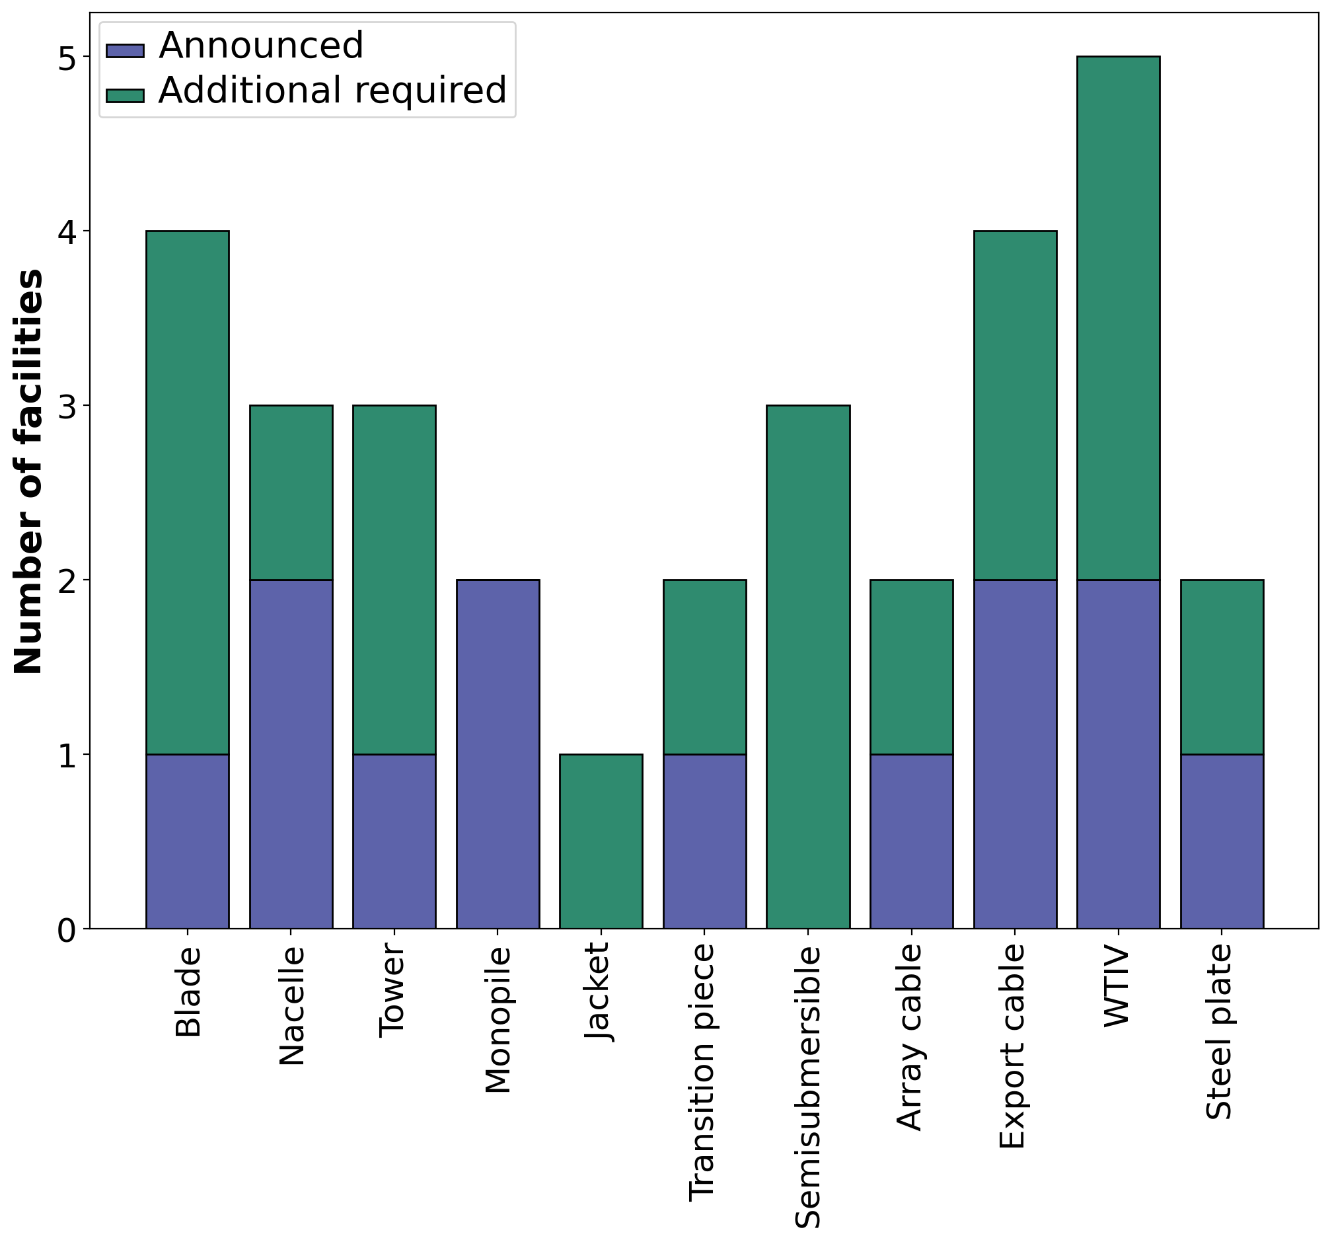
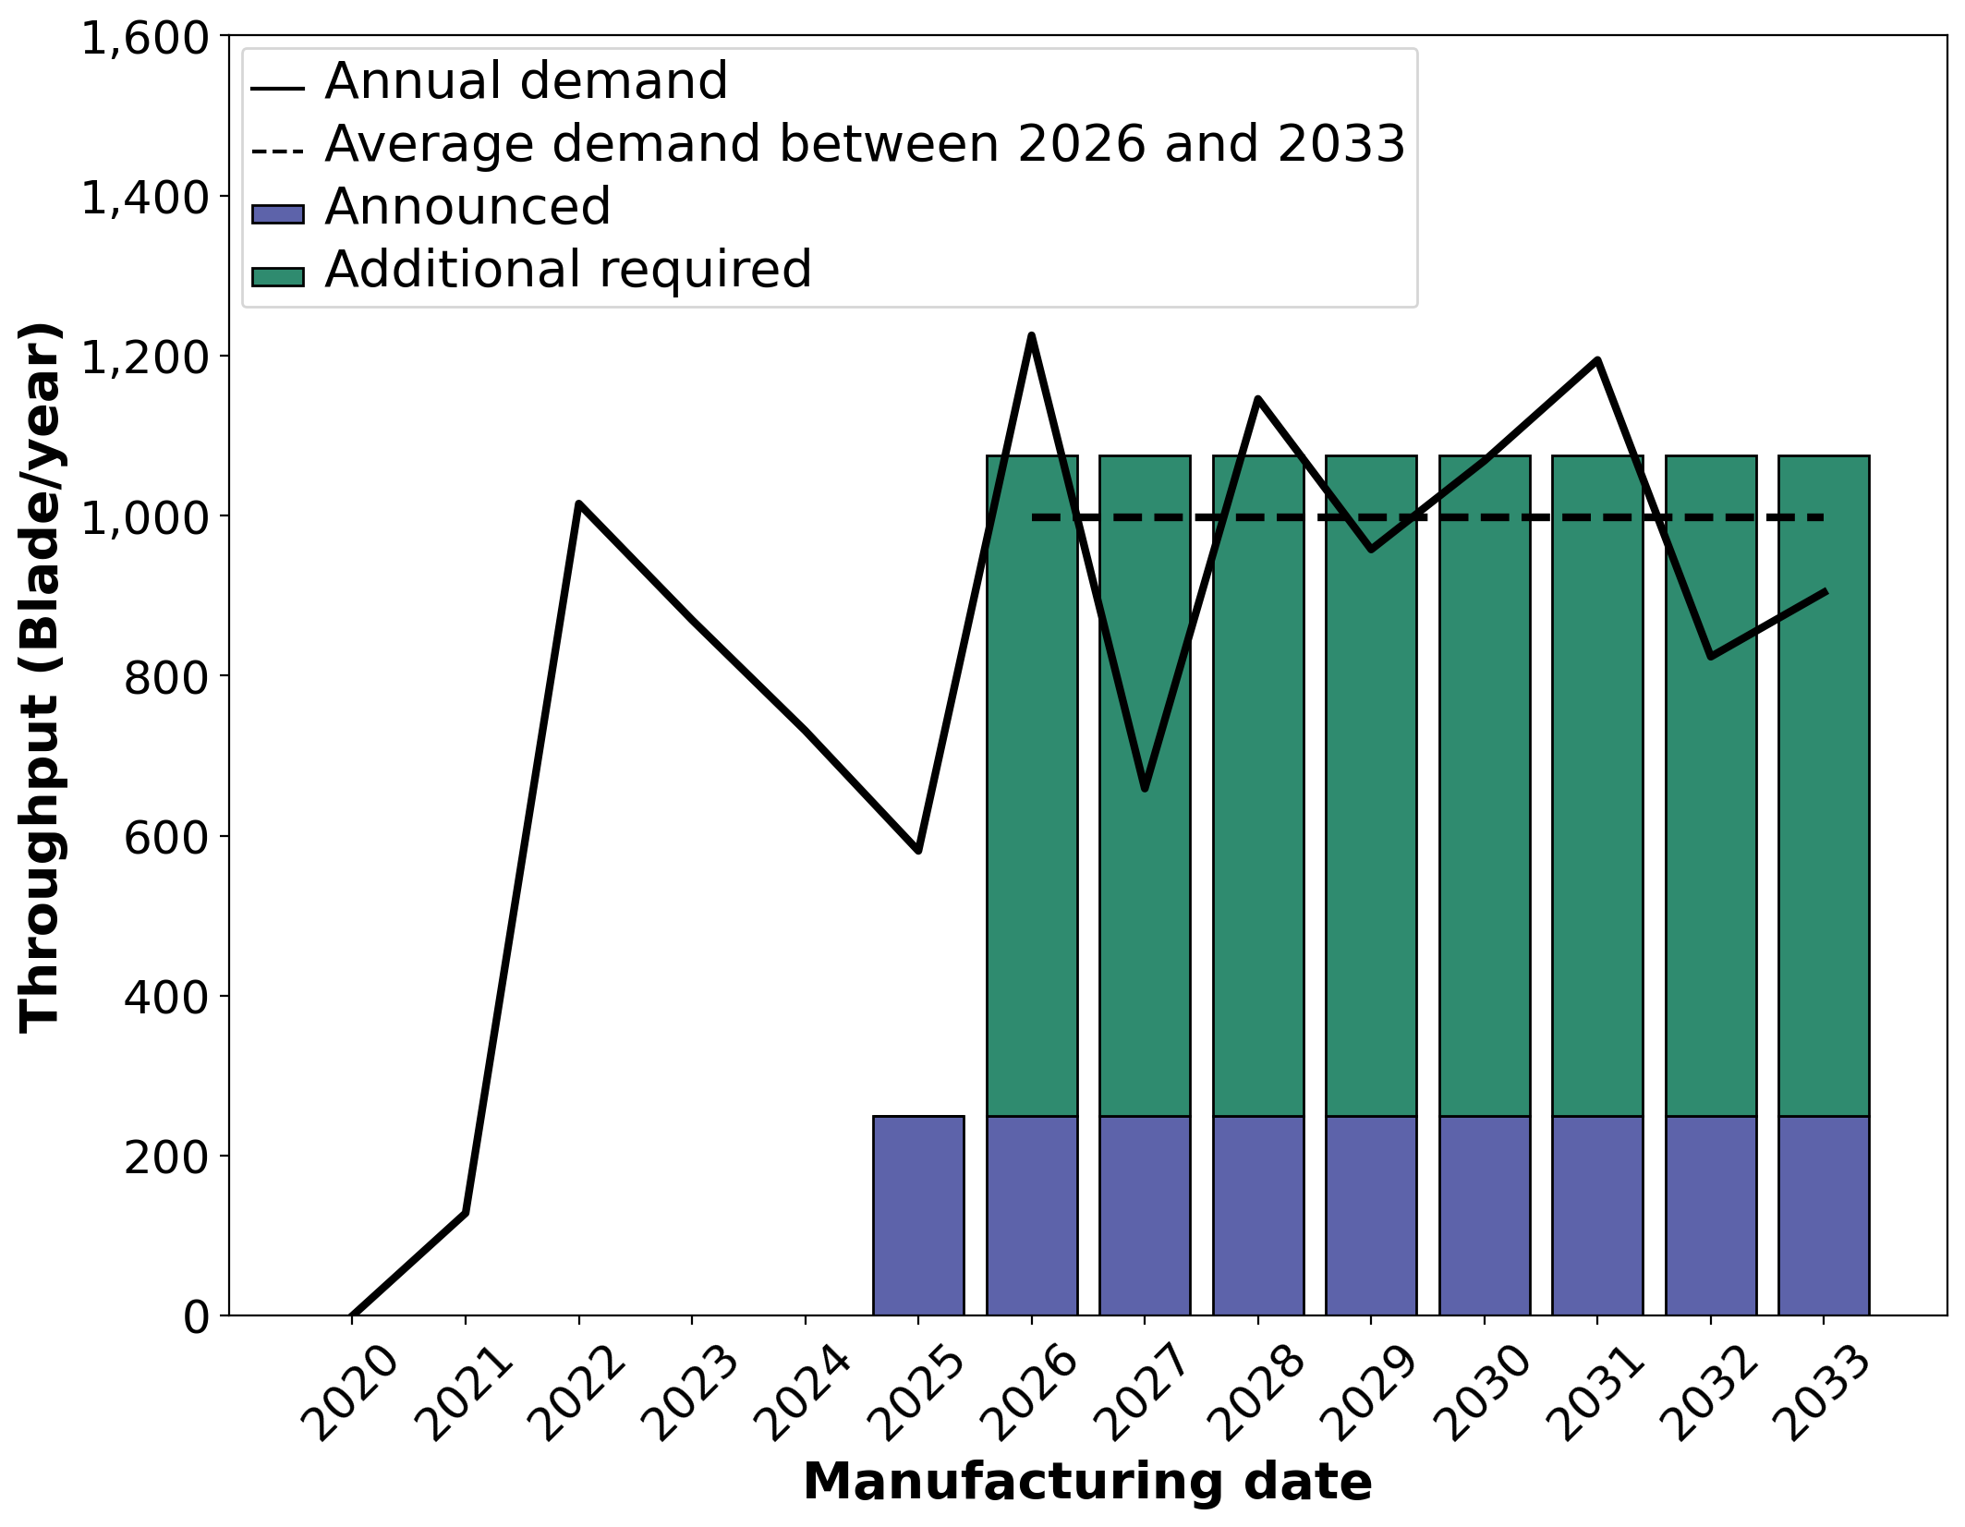
Demand for supply chain facilities
Establish the demand for major component facilities based on expected throughput of each facility
Annual demand from Shields et al, 2022
Example: blade facility
Repeat for each major component
25 required East Coast facilities
12 already announced
Will require additional floating facilities (WC turbine supply chain, mooring, anchors)

Slide 5
Manufacturing port facility requirements (Currently being reviewed by industry)
Component | Minimum laydown area (acres) | Quayside length (m) | Draft (m) | Bearing capacity (t/m2) | Required air draft (m)
Blade | 80 | 200 | 10 | 15 | 25
Nacelle | 30 | 200 | 10 | 15 | 25
Tower | 35 | 200 | 10 | 7.5 | 25
Monopile | 80 | 500 | 8 | 12 | 25
Jacket | 80 | 200 | 10 | 15 | 60
Cable | 45 | 150 | 10 | 15 | 50
Transition piece | 50 | 200 | 10 | 15 | 40
Steel plate | 200 | 200 | 10 | 15 | 25
Notes:
Better to simplify – 150 m for quayside, 10 m for draft
Beraring capacity is more relevant to equipment on land (crawler crane, ro/ros, spmts). 20 t/m2 didn’t matter at new Bedford – different load cases.
Simplfiy: length to 200 or 500.

Slide 6
Screen list of existing ports
Populate database of port characteristics
Add flags for:
States with existing offtake agreements/OSW targets
NY, NJ, MA, CT, MD, VA, NC, RI
Ports with existing OSW or other industry commitments
New Bedford, Brayton Point, Salem, Prov Port, State Pier, South Brooklyn, Albany, Pauslboro, Tradepoint Atlantic, Portsmouth, Savannah, Jacksonville, Miami, Mobile
Screen out facilities that do not meet (or are close to) port facility requirements
Port | State | Region | Laydown area (acres) | Quayside length (m) | Berth depth (m) | Channel depth (m) | Bearing capacity (t/m2) | Air draft restriction (m)
Searsport | ME | North Atlantic | 80 | 488 | 12.2 | 10.67 | 5 | 999
General Dynamics Bath Iron Works | ME | North Atlantic | 72 | 0 | 9.7 | 6.7 | 0 | 999
Schiller Newington, Portsmouth | NH | North Atlantic | 150 | 0 | 11.2 | 10.67 | 0 | 40.8
Salem | MA | North Atlantic | 42 | 484 | 9.75 | 9.75 | 0 | 999
GE Aviation, Lynn | MA | North Atlantic | 100 | 0 | 0 | 2.44 | 0 | 2.1
NSTAR facility, Lynn? | MA | North Atlantic | 40 | 0 | 0 | 0 | 0 | 999
Mystic River, Everett | MA | North Atlantic | 80 | 380 | 11.5 | 12.2 | 0 | 41.15
New Bedford | MA | North Atlantic | 30 | 366 | 9.1 | 9.1 | 20 | 999
etc

Slide 7
Identify preferred fabrication ports
Preferences used to prioritize ports for component fabrication:
Preference | Justification
Higher laydown area | OEMs prefer larger laydown areas to provide a larger buffer to alleviate project delays
Lower labor costs for workforce-intensive components | Facilities with higher number of FTEs (monopiles, jackets, blades) prefer to be in South Atlantic/GOM to reduce labor costs
Ports without existing OSW commitments | Existing/announced manufacturing/fabrication ports do not have room for further expansion (exception: New Jersey Wind Port, which is already aiming to attract new manufacturers as part of Phase 2 expansion)
Less congested ports | Major shipping ports are too congested/busy to accommodate OSW manufacturing
Ports in states with OSW commitments | New manufacturing facilities are more likely to get built in states with OSW targets/procurements to satisfy local content
Supply chain facilities are (roughly) evenly distributed among different states | Benefits will be more evenly distributed with Tier 1 facilities located in a range of states instead of clustered in Northeast.

Slide 8
Define high level port construction timelines and costs
Assumptions:
2 years of permitting and construction. May include some combination of expanding laydown area, bearing capacity upgrades, dredging.
Preliminary screening indicates that there are no ready-made ports that meet all manufacturing port requirement
Assign costs for each type of upgrade (request feedback on these values)
Expand laydown area: $100M
Expand berthage: $50M
Dredge berth: $50M
Dredge channel: $100M
Increase bearing capacity: $50M
Assume announcement dates of 2023 for all hypothetical facilties
Notes:
OK to keep upgrade costs as-is.
Move to 3 years of permitting/construction. Move in parallel to facility construction.
Anything can be hurried with intent by the right people – but message needs to be clear.

Slide 9
Baseline scenario for OSW fabrication ports Request feedback on how reasonable this is
 |  | Location |  |  | Timeline
Component | Factory | Port | State | Region | Announcement date | Port upgrade duration (yrs) | Facility construction (yrs) | Port/facility overlap (%) | Operational date
Blade | SGRE | Portsmouth Marine Terminal | VA | South Atlantic | 2021 | 0 | 3 | 0 | 2024
 | Blade 1 | General Cargo Terminal at Port of Wilmington | NC | South Atlantic | 2023 | 1.5 | 3 | 0 | 2027
 | Blade 2 | Newport News Marine Terminal | VA | South Atlantic | 2023 | 1.5 | 3 | 0 | 2027
 | Blade 3 | New Jersey Wind Port | NJ | Central Atlantic | 2023 | 4 | 3 | 0 | 2030
Nacelle | GE | New Jersey Wind Port | NJ | Central Atlantic | 2021 | 2 | 3 | 0.333333333 | 2025
 | Vestas | New Jersey Wind Port | NJ | Central Atlantic | 2021 | 2 | 3 | 0.333333333 | 2025
 | Nacelle 1 | GE Aviation, Lynn | MA | North Atlantic | 2023 | 3 | 3 | 0 | 2029
 | Nacelle 2 | South Quay | RI | North Atlantic | 2023 | 3 | 3 | 0 | 2029
Tower | Marmen Welcon | Port of Albany | NY | Central Atlantic | 2021 | 2.5 | 2.5 | 0.8 | 2024
 | Tower 1 | Tradepoint Atlantic | MD | South Atlantic | 2023 | 1.5 | 2.5 | 0 | 2027
 | Tower 2 | Searsport | ME | North Atlantic | 2023 | 1.5 | 2.5 | 0 | 2027
Monopile | EEW | Port of Paulsboro | NJ | Central Atlantic | 2020 | 2 | 2 | 0.5 | 2023
 | US Wind | Tradepoint Atlantic | NJ | South Atlantic | 2021 | 0 | 3.5 | 0 | 2024
Jacket | Jacket 1 | Port of New Orleans | LA | Gulf of Mexico | 2023 | 1 | 1 | 0 | 2025
Transition piece | Smulders | Port of Albany | NY | Central Atlantic | 2021 | 2.5 | 2.5 | 0.25 | 2025
 | TP 1 | Port of Coeymans | NY | Central Atlantic | 2023 | 2 | 2.5 | 0 | 2027
Array cable | Hellenic | Tradepoint Atlantic | MD | South Atlantic | 2021 | 1.5 | 5 | 0 | 2027
 | Array cable 1 | Arthur Kill Terminal | NY | Central Atlantic | 2023 | 3.5 | 5 | 0.2 | 2030
 | Array cable 2 | Mystic River, Everett | MA | North Atlantic | 2023 | 2 | 3 | 0 | 2028
Export cable | Nexans | Goose Island | SC | South Atlantic | 2018 | n/a | n/a | n/a | 2020
 | Prysmian | Brayton Point | MA | North Atlantic | 2021 | 1.5 | 5 | 0 | 2027
 | Export cable 1 | Quonset Business Park / Port of Davisville | RI | North Atlantic | 2023 | 2 | 5 | 0 | 2030
 | Export cable 2 | Radio Island, Morehead City | NC | South Atlantic | 2023 | 2.5 | 5 | 0 | 2030
Steel plates | Nucor | Brandenburg | KY | South Atlantic | 2021 | 0 | 2 | 0 | 2023
 | Steel plate 1 | Port of Brunswick | GA | South Atlantic | 2023 | 1.5 | 5 | 0 | 2029
Includes announced facilities and additional required facilities (ie, Blade 1, Blade 2,..)
Notes:
Why 2 blades in VA? What about Everett (close to test facility).
Can probably remove 1 nacelle facility. 1 per OEM.
TP facility at New London?
Additional scenarios – GBFs. Clusters. Higher deployment.
CT interested in a GBF facility. Not sure where.
Decision makers/labor need to know about assumptions that facilities push towards lower labor $ regions. Make clear message in report.
Concrete GBF – lots of jobs.

Slide 10
Baseline scenario for OSW fabrication ports
Port upgrade and facility construction schedule for domestic supply chain scenario.
Includes announced facilities and additional required facilities (ie, Blade 1, Blade 2,..)
Notes:
Grouped bar chart pf facilities and corresponding # jobs

Slide 11
Next steps
Review and revise port capabilities and OEM port requirements
Update facility/port assignments as necessary
Develop additional scenarios
Cluster facilities in Northeast
Higher annual deployment
Include West Coast

Slide 12
Marshaling and WTIV bottleneck assessment

Slide 13
Approach
Define a static list of project characteristics, including:
Site characteristics (depth, distance to port)
Project characteristics (capacity, turbine choice)
‘intended’ start date for installation
Assigned marshalling port
Define WTIV and port scenarios (number and date available)
Simulate the installation of the entire pipeline using CORAL model
Individual project logistics modeled using ORBIT process-based model (installation steps with hourly resolution)
Project can not begin until its assigned port and one of the pool of WTIVs are available
Output Gantt chart showing delays and installed capacity through 2030

Slide 14
Assumptions and caveats
We only modeling turbine and monopile installation, effectively assuming that cables, etc, can be installed in parallel without contributing bottlenecks
We assume all projects use feeder barges and that there are 10 barges readily available throughout the simulation (easy to change). It would be a bit of work to update the code to have all projects use WTIVs, and a bit more work to have WTIV/feeder strategies assigned to specific projects.
We account for pile-driving weather window restrictions for monopiles (start dates are May or June).
Each project installation time includes weather delays based on a representative East Coast weather time series (taken from the Vineyard lease area).
We don’t evaluate limitations of fabrication or storage ports, but we should come up with some sort of multiplier to evaluate the demand for these additional port requirements.
We assume that 2.5 GW of floating will be installed in CA by 2030 (optimistically) so reaching 27.5 GW on the East Coast gets us to the 30 GW target
Additional port/vessel investments need to be made 3 years before asset is available
WTIV: $500M
Port: $400M

Slide 15
Deployment assessment with existing infrastructure
Resources | 2023 | 2024 | 2025 | 2026 | 2027 | 2028 | 2029 | 2030
Ports | 2 | 3 | 5 | 5 | 6 | 6 | 6 | 6
WTIV | 1 | 1 | 2 | 2 | 2 | 3 | 3 | 3
Feeders | 4 | 4 | 4 | 4 | 4 | 4 | 4 | 4
WTIV assumptions
2023: European WTIV available. Replaced by Charybdis in early 2024
2025: Equinor/Maersk vessel available
2028: New WTIV built at Keppel AmFELS
Port assumptions
2023: New Bedford and New London
2024: Add Portsmouth Marine Terminal
2025: Add New Jersey Wind Port and Tradepoint Atlantic
2027: Add South Brooklyn Marine Terminal
Notes:
Port assumptions:
Current funding – NB, NL, PMT
NO money for NJWP, TPA, Salem, NJWP expansion, AKT
NJWP not very far in permitting.
Feeders: Crowley has 4. Probably ~6 available now.
Crowely wants to build 2. Foss wants to build some.
100 x 400
Consider the floating feeder system?

Slide 16
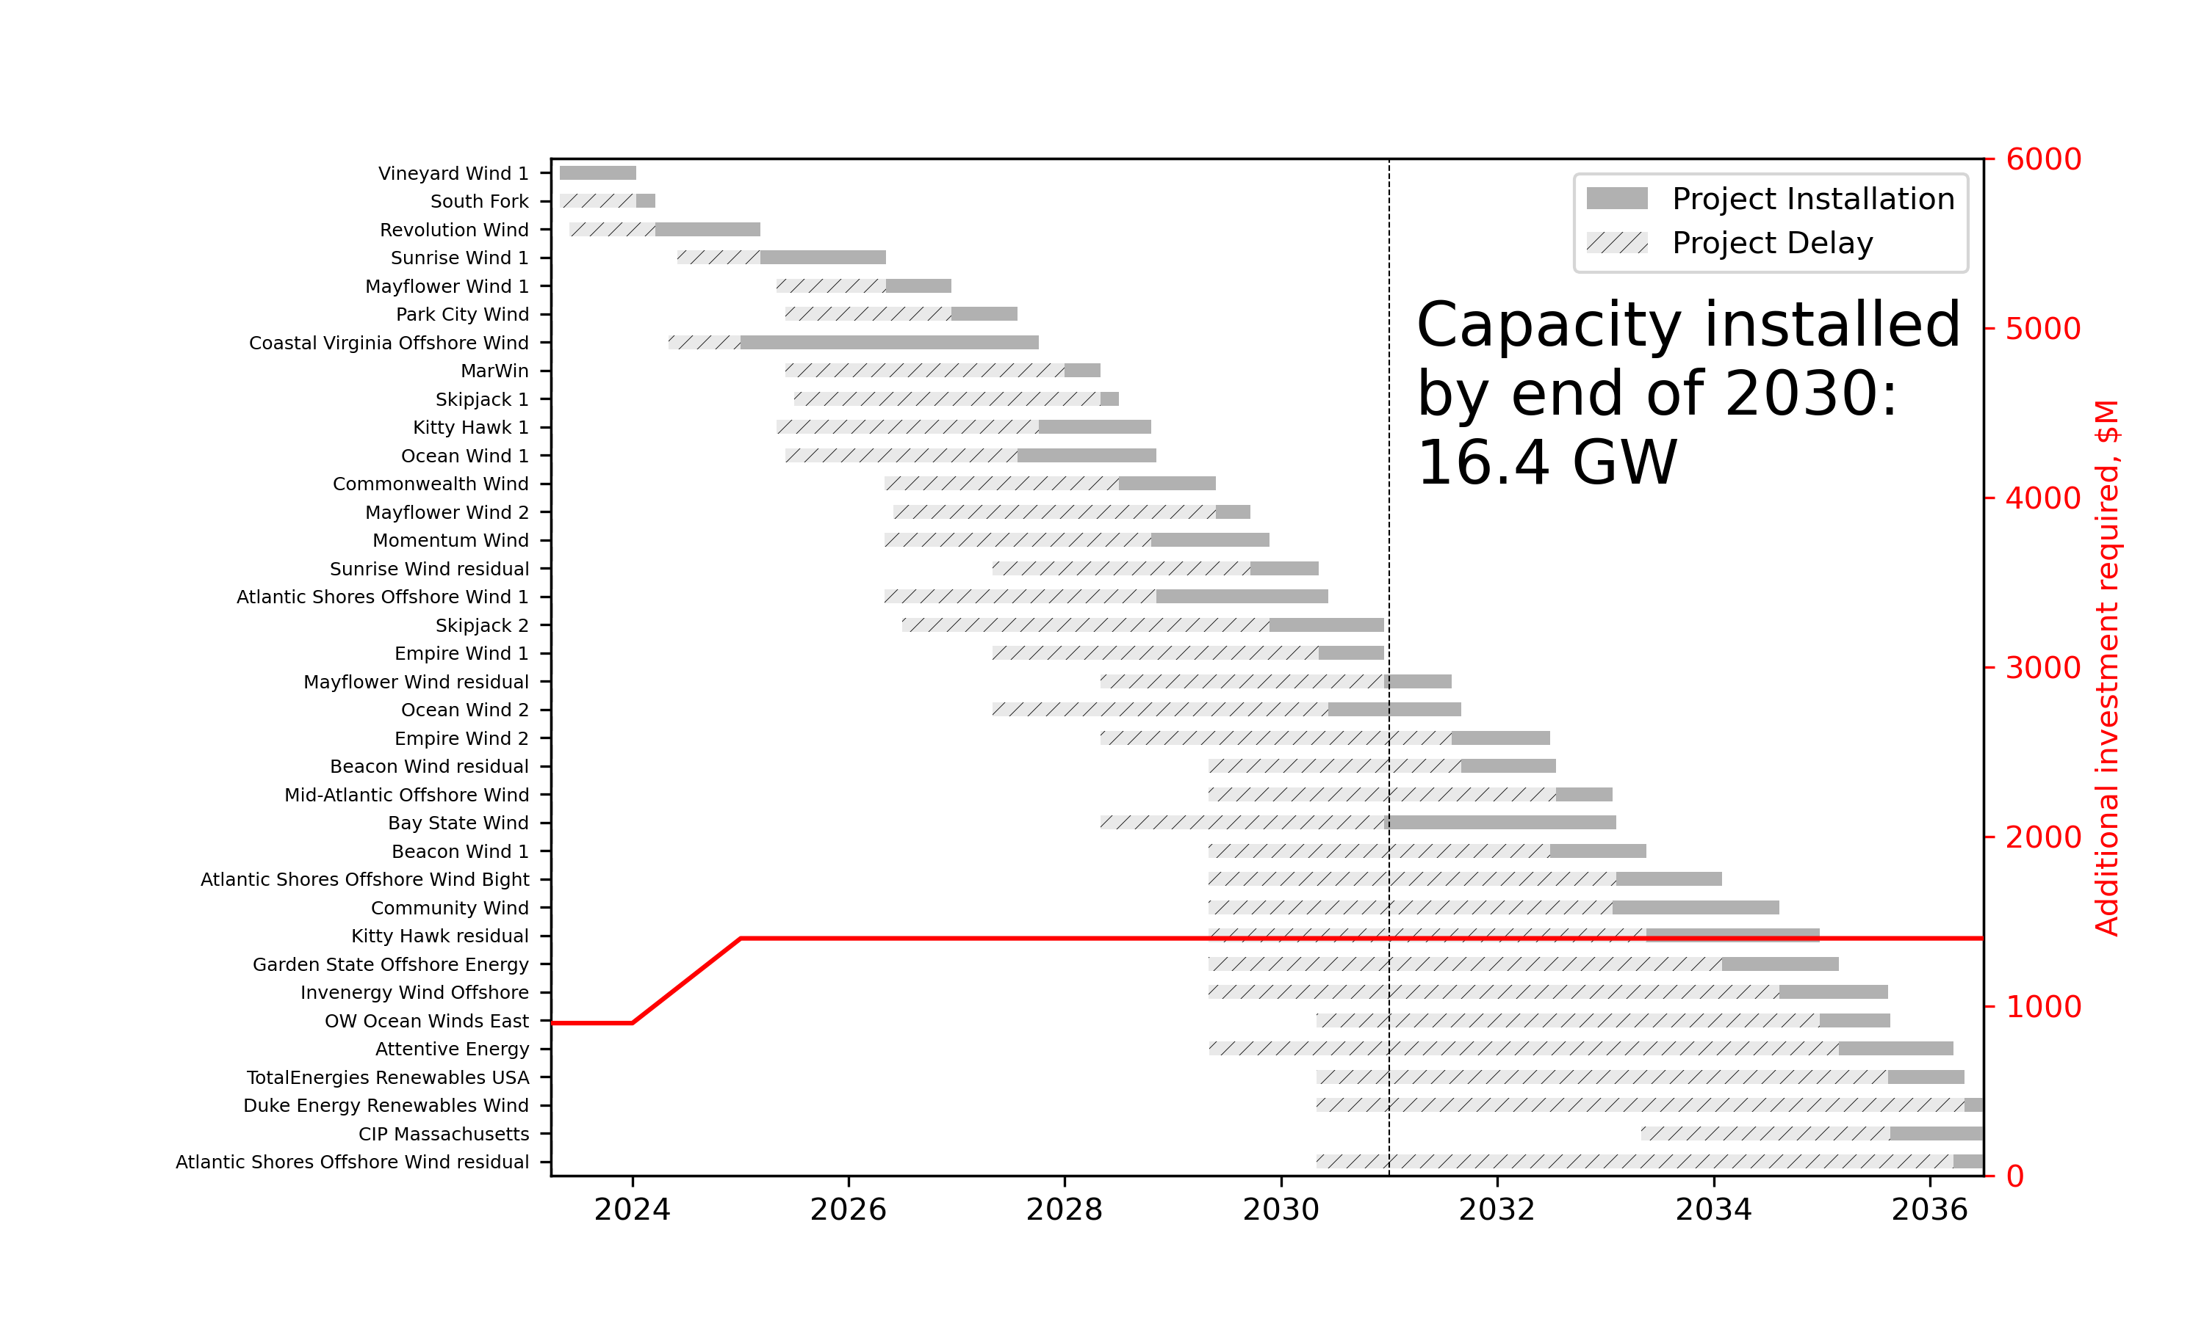

Slide 17
Deployment assessment with existing ports and additional WTIVs
Resources | 2023 | 2024 | 2025 | 2026 | 2027 | 2028 | 2029 | 2030
Ports | 2 | 3 | 5 | 5 | 6 | 6 | 6 | 6
WTIV | 1 | 1 | 2 | 3 | 3 | 5 | 6 | 6
Feeders | 4 | 4 | 4 | 4 | 4 | 4 | 4 | 4
WTIV assumptions
2023: European WTIV available. Replaced by Charybdis in early 2024
2025: Equinor/Maersk vessel available
2026: New WTIV built at Keppel AmFELS
2028: 2 new WTIVs built at other US shipyards
2029: New WTIV built at Keppel AmFELS
(Changes from baseline case)
Port assumptions
2023: New Bedford and New London
2024: Add Portsmouth Marine Terminal
2025: Add New Jersey Wind Port and Tradepoint Atlantic
2027: Add South Brooklyn Marine Terminal

Slide 18
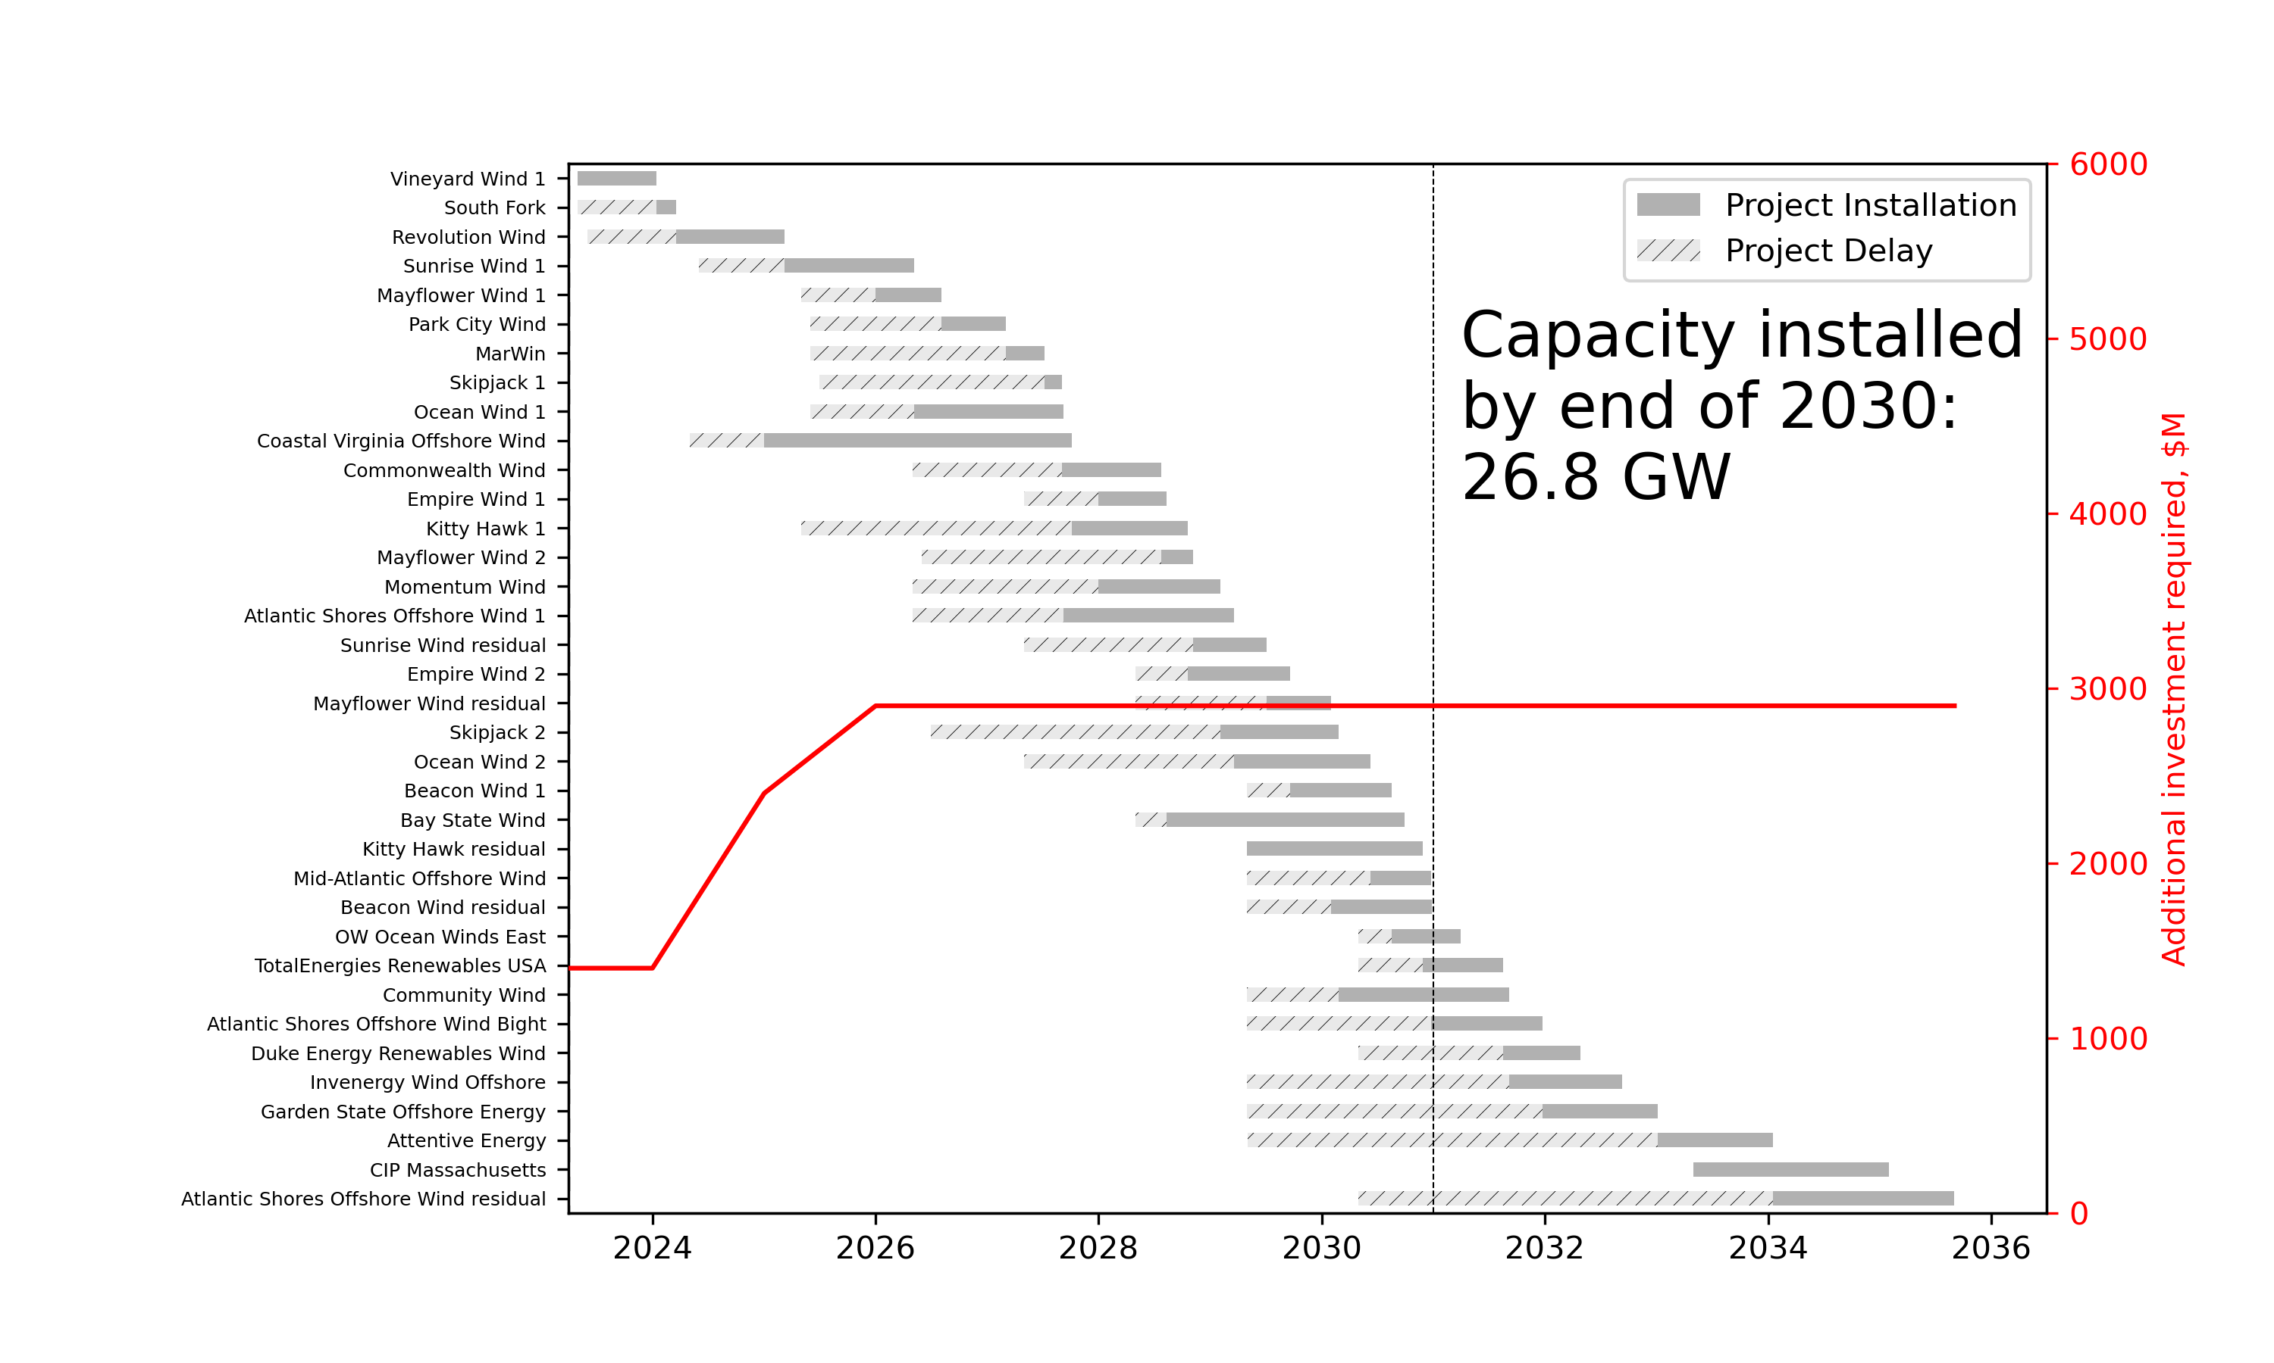

Slide 19
Deployment assessment with existing WTIVs and additional ports
Resources | 2023 | 2024 | 2025 | 2026 | 2027 | 2028 | 2029 | 2030
Ports | 2 | 3 | 5 | 5 | 7 | 8 | 9 | 9
WTIV | 1 | 1 | 2 | 2 | 2 | 3 | 3 | 3
Feeders | 4 | 4 | 4 | 4 | 4 | 4 | 4 | 4
WTIV assumptions
2023: European WTIV available. Replaced by Charybdis in early 2024
2025: Equinor/Maersk vessel available
2028: New WTIV built at Keppel AmFELS
Port assumptions
2023: New Bedford and New London
2024: Add Portsmouth Marine Terminal
2025: Add New Jersey Wind Port and Tradepoint Atlantic
2027: Add South Brooklyn Marine Terminal and Salem
2028: Add New Jersey Wind Port (phase 2)
2029: Add Arthur Kill Terminal
(Changes from baseline case)
Notes:
Port assumptions:
Current funding – NB, NL, PMT
NO money for NJWP, TPA, Salem, NJWP expansion, AKT
NJWP not very far in permitting.
Feeders: Crowley has 4. Probably ~6 available now.
Crowely wants to build 2. Foss wants to build some.
100 x 400
Consider the floating feeder system?

Slide 20
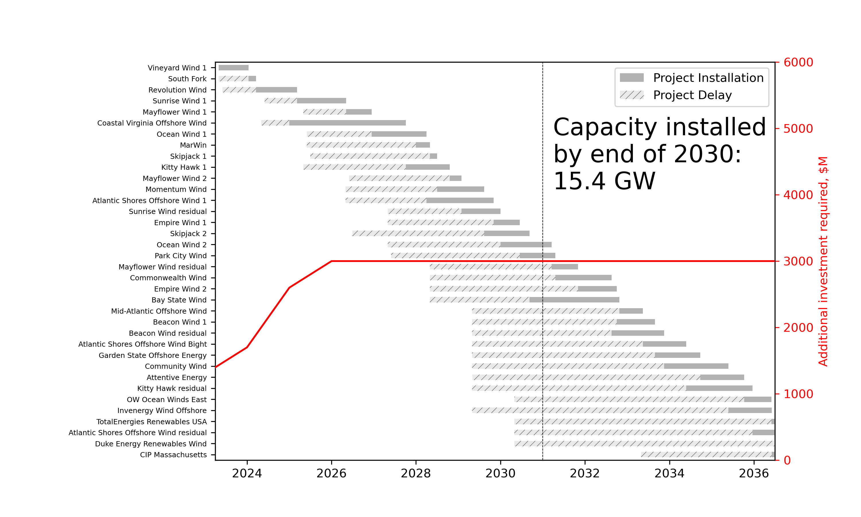

Slide 21
Deployment assessment with additional US WTIVs and additional ports
Resources | 2023 | 2024 | 2025 | 2026 | 2027 | 2028 | 2029 | 2030
Ports | 2 | 3 | 5 | 5 | 7 | 8 | 9 | 9
WTIV | 1 | 1 | 2 | 3 | 3 | 5 | 6 | 6
Feeders | 4 | 4 | 4 | 4 | 4 | 4 | 4 | 4
WTIV assumptions
2023: European WTIV available. Replaced by Charybdis in early 2024
2025: Equinor/Maersk vessel available
2026: New WTIV built at Keppel AmFELS
2028: 2 new WTIVs built at other US shipyards
2029: New WTIV built at Keppel AmFELS
Port assumptions
2023: New Bedford and New London
2024: Add Portsmouth Marine Terminal
2025: Add New Jersey Wind Port and Tradepoint Atlantic
2027: Add South Brooklyn Marine Terminal and Salem
2028: Add New Jersey Wind Port (phase 2)
2029: Add Arthur Kill Terminal
Notes:
Port assumptions:
Current funding – NB, NL, PMT
NO money for NJWP, TPA, Salem, NJWP expansion, AKT
NJWP not very far in permitting.
Feeders: Crowley has 4. Probably ~6 available now.
Crowely wants to build 2. Foss wants to build some.
100 x 400
Consider the floating feeder system?

Slide 22
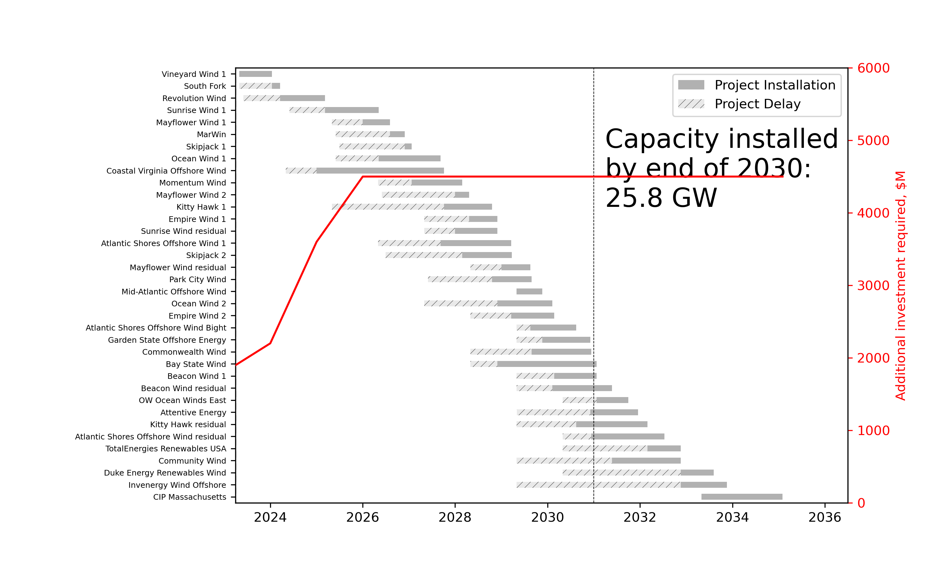

Slide 23
Deployment assessment with additional US and European WTIVs and additional ports
Resources | 2023 | 2024 | 2025 | 2026 | 2027 | 2028 | 2029 | 2030
Ports | 2 | 3 | 5 | 5 | 7 | 8 | 9 | 9
WTIV | 2 | 2 | 3 | 4 | 4 | 6 | 7 | 7
Feeders | 4 | 4 | 4 | 4 | 4 | 4 | 4 | 4
WTIV assumptions
2023: 2 European WTIVs available. One remains available to US market. Other is replaced by Charybdis in 2024.
2025: Equinor/Maersk vessel available
2026: New WTIV built at Keppel AmFELS
2028: 2 new WTIVs built at other US shipyards
2029: New WTIV built at Keppel AmFELS
Port assumptions
2023: New Bedford and New London
2024: Add Portsmouth Marine Terminal
2025: Add New Jersey Wind Port and Tradepoint Atlantic
2027: Add South Brooklyn Marine Terminal and Salem
2028: Add New Jersey Wind Port (phase 2)
2029: Add Arthur Kill Terminal
(Most optimistic scenario)
Notes:
Port assumptions:
Current funding – NB, NL, PMT
NO money for NJWP, TPA, Salem, NJWP expansion, AKT
NJWP not very far in permitting.
Feeders: Crowley has 4. Probably ~6 available now.
Crowely wants to build 2. Foss wants to build some.
100 x 400
Consider the floating feeder system?

Slide 24
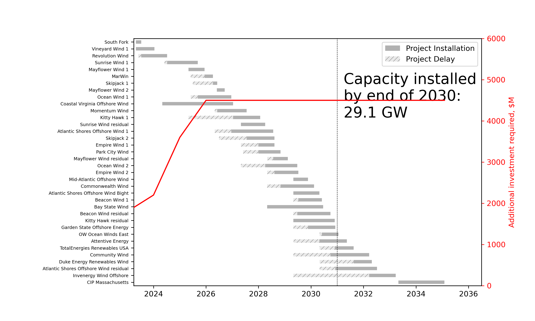

Slide 25
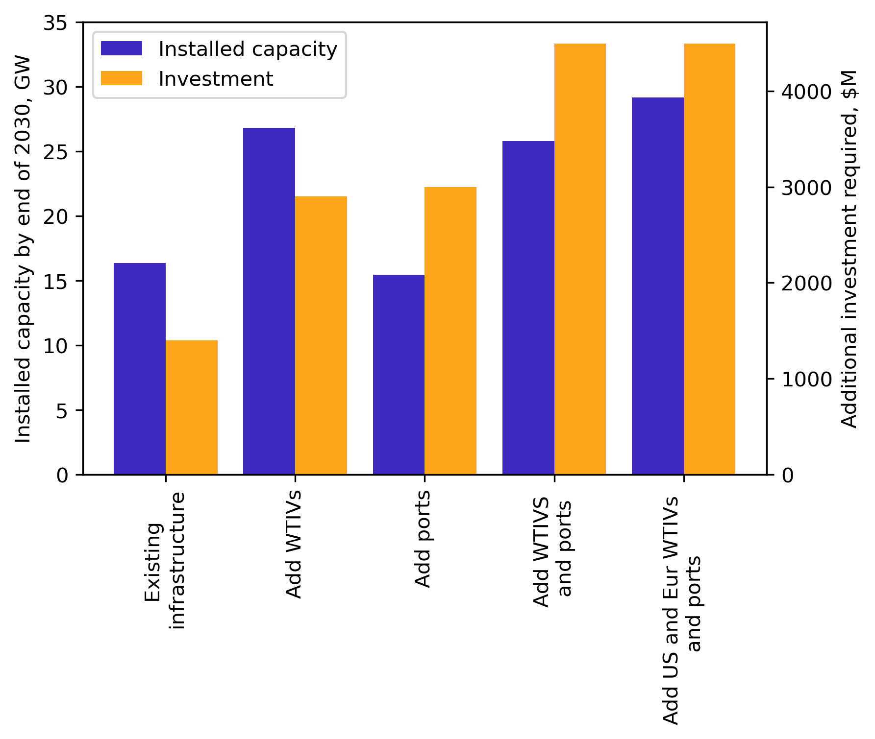
Summary

Slide 26
Key takeaways
Existing infrastructure limits 2030 target by 50% (15.6 GW)
Steadily increasing the WTIV fleet to 6 by 2029 would significantly reduce this bottleneck at a total investment of at least $3B
Number of announced marshaling ports is likely sufficient to support the pipeline, but will require an additional investment of over $1B to get these ports constructed on time
Contracting at least 1 European WTIV in the early 2020s will help to alleviate bottlenecks in the second half of the decade. This will probably be required to meet the 30 GW target given the lead time to build WTIVs

Slide 27
Old results

Slide 28
Scenarios – high resource availability
Resources | 2023 | 2024 | 2025 | 2026 | 2027 | 2028 | 2029 | 2030
Ports | 2 | 5 | 8 | 8 | 9 | 9 | 9 | 9
WTIV | 1 | 1 | 2 | 3 | 3 | 5 | 6 | 6
Feeders | 10 | 10 | 10 | 10 | 10 | 10 | 10 | 10
WTIV assumptions
2023: European WTIV available. Replaced by Charybdis in early 2024
2025: Equinor/Maersk vessel available
2026: New WTIV built at Keppel AmFELS
2028: 2 new WTIVs built at other US shipyards
2029: New WTIV built at Keppel AmFELS
WTIV assumptions (additional European WTIV)
2023: 2 European WTIV available. Replaced by Charybdis in early 2024
2025: Equinor/Maersk vessel available
2026: New WTIV built at Keppel AmFELS
2028: 2 new WTIVs built at other US shipyards
2029: New WTIV built at Keppel AmFELS
Port assumptions (pretty optimistic scenario)
2023: New Bedford and New London
2024: Add Portsmouth Marine Terminal, New Jersey Wind Port, Tradepoint Atlantic
2025: Add Salem, South Brooklyn. Expand New Jersey Wind Port to have 2 marshaling berths
2027: Add Arthur Kill
Port assumptions (more realistic schedule)
2023: New Bedford and New London
2024: Add Portsmouth Marine Terminal
2025: Tradepoint Atlantic
2026: NJWP
2027: Salem, SBMT
2028: NJWP 2
2029: AKT
2030:
Notes:
Port assumptions:
Current funding – NB, NL, PMT
NO money for NJWP, TPA, Salem, NJWP expansion, AKT
NJWP not very far in permitting.
Feeders: Crowley has 4. Probably ~6 available now.
Crowely wants to build 2. Foss wants to build some.
100 x 400
Consider the floating feeder system?

Slide 29
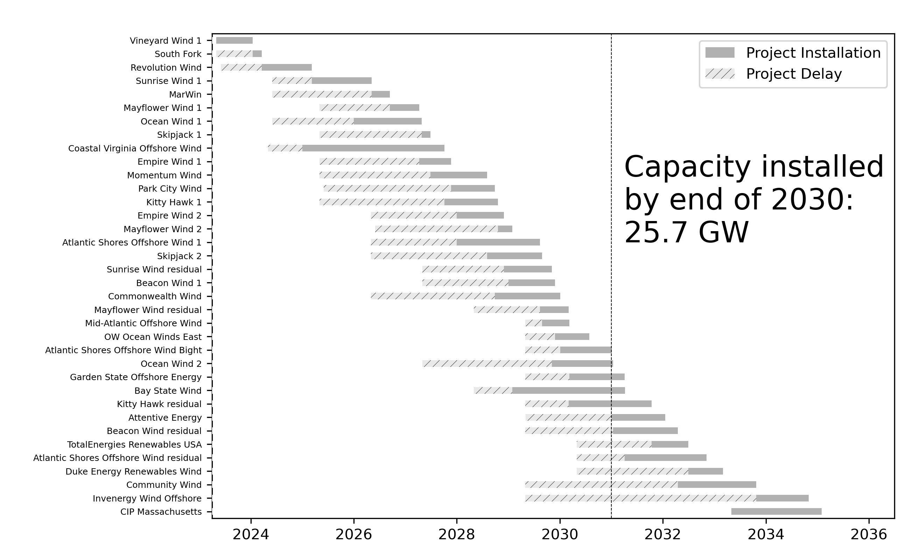
Scenarios – high resource availability
Resources | 2023 | 2024 | 2025 | 2026 | 2027 | 2028 | 2029 | 2030
Ports | 2 | 5 | 8 | 8 | 9 | 9 | 9 | 9
WTIV | 1 | 1 | 2 | 3 | 3 | 5 | 6 | 6
Feeders | 10 | 10 | 10 | 10 | 10 | 10 | 10 | 10
Notes:
Show cumulative investment and timeframes for investment
Scale bar width with project capacity

Slide 30
Scenarios – limited WTIVs
Resources | 2023 | 2024 | 2025 | 2026 | 2027 | 2028 | 2029 | 2030
Ports | 2 | 5 | 8 | 8 | 9 | 9 | 9 | 9
WTIV | 1 | 1 | 2 | 2 | 2 | 3 | 3 | 3
Feeders | 10 | 10 | 10 | 10 | 10 | 10 | 10 | 10
WTIV assumptions
2023: European WTIV available. Replaced by Charybdis in early 2024
2025: Equinor/Maersk vessel available
2028: New WTIV built at Keppel AmFELS
(This is a pretty realistic scenario)
Port assumptions
2023: New Bedford and New London
2024: Add Portsmouth Marine Terminal, New Jersey Wind Port, Tradepoint Atlantic
2025: Add Salem, South Brooklyn. Expand New Jersey Wind Port to have 2 marshaling berths
2027: Add Arthur Kill

Slide 31
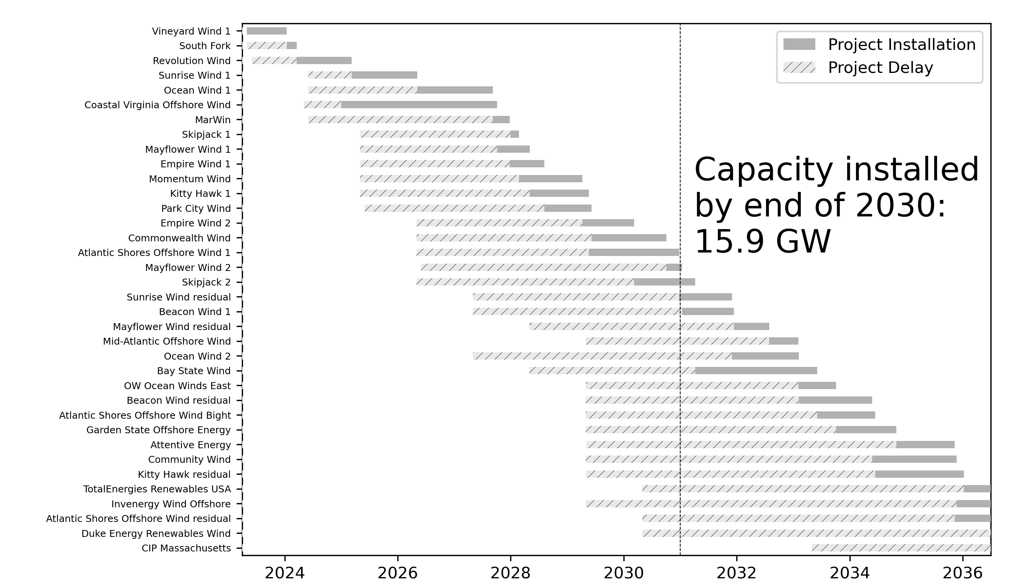
Scenarios – limited WTIVs
Resources | 2023 | 2024 | 2025 | 2026 | 2027 | 2028 | 2029 | 2030
Ports | 2 | 5 | 8 | 8 | 9 | 9 | 9 | 9
WTIV | 1 | 1 | 2 | 2 | 2 | 3 | 3 | 3
Feeders | 10 | 10 | 10 | 10 | 10 | 10 | 10 | 10

Slide 32
Scenarios – additional use of European WTIVs
Resources | 2023 | 2024 | 2025 | 2026 | 2027 | 2028 | 2029 | 2030
Ports | 2 | 5 | 8 | 8 | 9 | 9 | 9 | 9
WTIV | 2 | 2 | 2 | 3 | 3 | 5 | 6 | 6
Feeders | 10 | 10 | 10 | 10 | 10 | 10 | 10 | 10
WTIV assumptions
2023: 2 European WTIVs available. One remains available to US market. Other is replaced by Charybdis in 2024.
2025: Equinor/Maersk vessel available
2028: New WTIV built at Keppel AmFELS
Port assumptions
2023: New Bedford and New London
2024: Add Portsmouth Marine Terminal, New Jersey Wind Port, Tradepoint Atlantic
2025: Add Salem, South Brooklyn. Expand New Jersey Wind Port to have 2 marshaling berths
2027: Add Arthur Kill

Slide 33
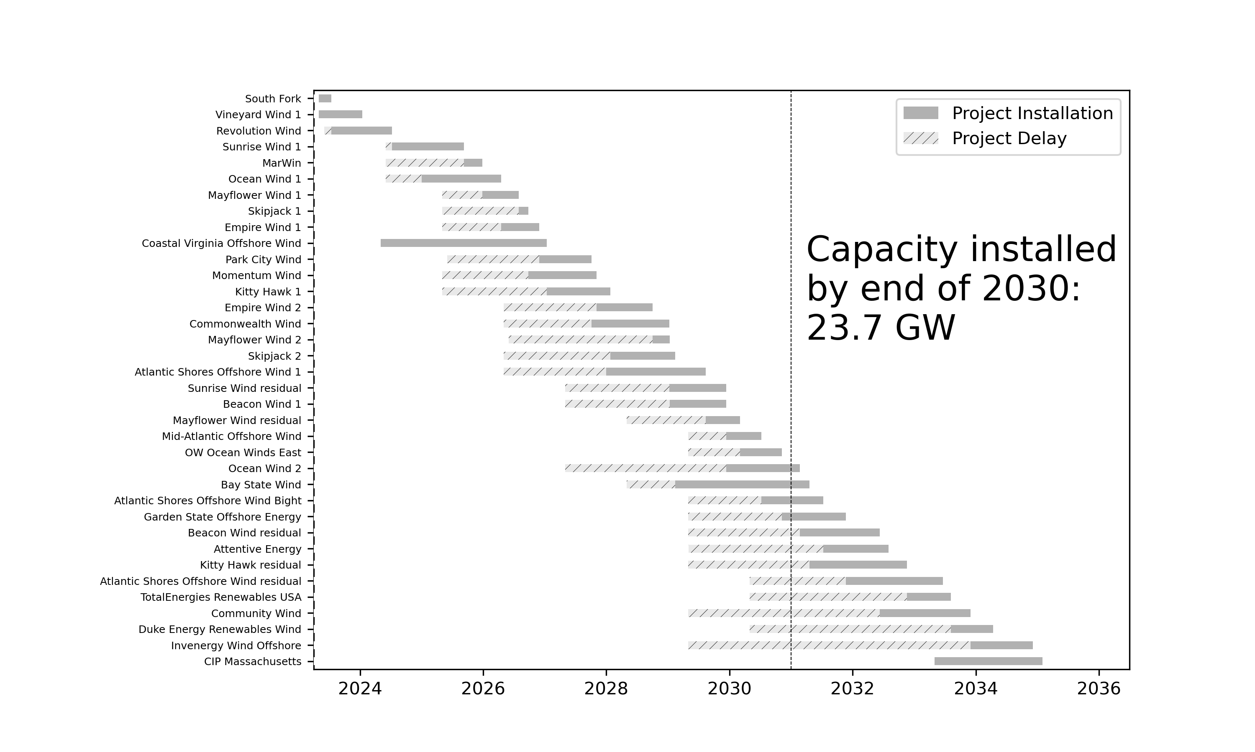
Scenarios – additional European WTIVs
Resources | 2023 | 2024 | 2025 | 2026 | 2027 | 2028 | 2029 | 2030
Ports | 2 | 5 | 8 | 8 | 9 | 9 | 9 | 9
WTIV | 2 | 2 | 2 | 3 | 3 | 5 | 6 | 6
Feeders | 10 | 10 | 10 | 10 | 10 | 10 | 10 | 10

Slide 34
Next steps
Review results for accuracy
Consider expanding to include fabrication port demand
Multiplier from number of marshaling ports?
Explore additional scenarios
Limited feeder barges
Delays in port availability/construction
Write up into PPT, roadmap report

